Slide 1
Matter and Density
A presentation by Science Doodles

Slide 2
Vocabulary Words
Classify
Physical state
Properties
Matter
Mass
Relative density

Slide 3
Classify

Slide 4
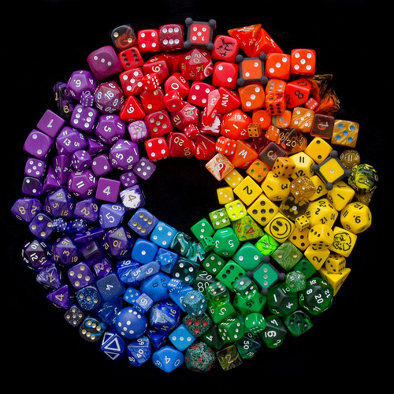

Slide 5
Physical state

Slide 6
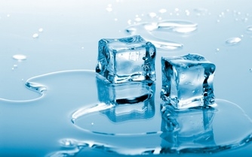

Slide 7
Properties

Slide 9
Matter

Slide 10
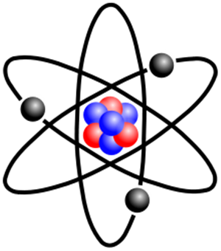

Slide 11
Mass

Slide 12
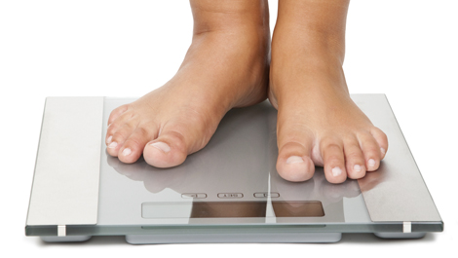

Slide 13
Relative density

Slide 15
Quiz

Slide 16
What is it when objects that are more dense sink in water, and less dense objects float in water?

Slide 17
What is the classification of matter as a solid, liquid, or gas?

Slide 18
What is it when things are grouped together based on similar traits?

Slide 19
What is anything that has mass and takes up space?

Slide 20
What are appearances of an object including: mass, magnetism, physical state, relative density, solubility, and the ability to insulate or conduct?

Slide 21
What is the amount of matter in an object?

Slide 22
Sources
http://data.whicdn.com/images/48177244/large.jpg
http://derekpunterscience7.weebly.com/uploads/1/3/8/7/13878391/985542709.jpg?335
http://pacificlegionbaseball.org/images/baseball_glove.jpg
http://www.ridge.k12.wa.us/cms/lib01/WA01000666/Centricity/Domain/121/Poperties%20of%20Matter.png
https://static.sharecare.com/promo/topics/body-mass-index.jpg
http://hirportal.sikerado.hu/images/kep/201407/vizilabda.jpg

